Slide 1

SALES & FINANCE ANALYTICS
Of AtliQ Hardware
AtliQ Hardware is a leading provider of computer hardware components. With a wide range of products and a substantial customer base, it is crucial for AtliQ Hardware to understand its sales performance in detail. This Sales Analytics project aims to leverage historical sales data to gain insights into sales patterns, customer behavior, and product performance

Slide 2

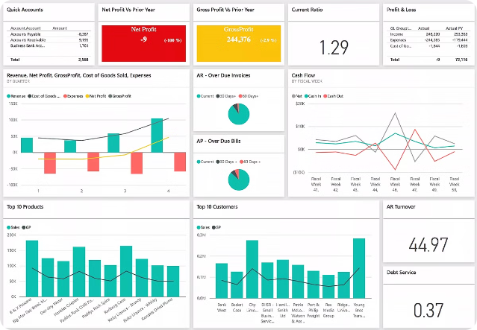
222
Profit and Loss Statement
The profit and loss statement is a key financial document that summarizes a company's revenues, costs, and expenses over a specific period of time. It provides a clear picture of a business's profitability and financial performance.
AV

Slide 3

Net Sales
Definition
Importance
Calculation
Net sales represent the total amount of revenue a company generates from its core business activities, minus any discounts, returns, or allowances.
Net sales is a critical metric that helps businesses track their top-line growth and overall market performance.
Net Sales = Gross Sales - Discounts, Returns, and Allowances

Slide 4

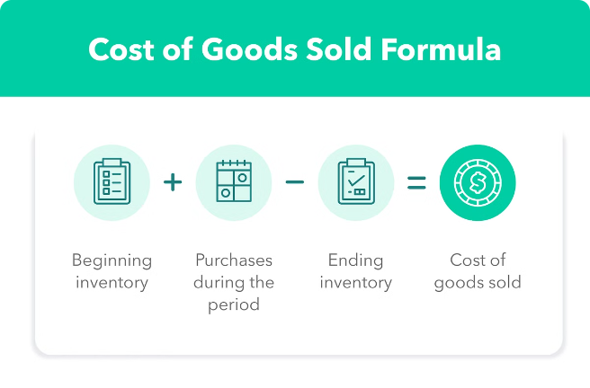
Cost of Goods Sold (COGS)
Definition
COGS represents the direct costs associated with producing the goods or services a company sells.
Includes
Raw materials, labor, and manufacturing overhead costs.
Importance
COGS is a crucial metric for understanding a company's profitability and gross margin.
Calculation
COGS = Manufacturing Cost+ Freight Cost +Other Cost

Slide 5


Gross Margin
1
Definition
Gross margin is the difference between net sales and the cost of goods sold.
2
Importance
Gross margin is a key indicator of a company's profitability and efficiency.
3
Calculation
Gross Margin = Net Sales - Cost of Goods Sold

Slide 6

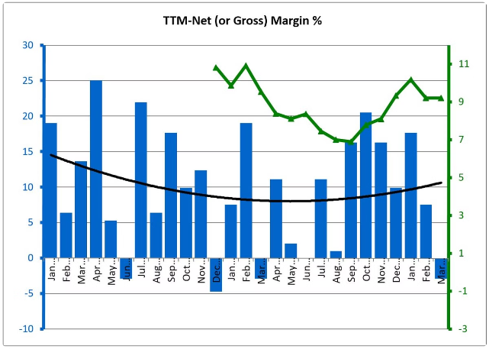
Gross Margin Percentage
1
Definition
Gross margin percentage is the ratio of gross margin to net sales, expressed as a percentage.
2
Importance
It provides insight into a company's pricing power and operational efficiency.
3
Calculation
Gross Margin Percentage = (Gross Margin / Net Sales) x 100

Slide 7

Operational Expenses
Definition
Includes
Importance
Operational expenses, or OpEx, are the ongoing costs associated with running a business, excluding the cost of goods sold.
Rent, utilities, salaries, marketing, and administrative expenses.
OpEx analysis helps management identify areas for cost reduction and improve overall profitability.

Slide 8


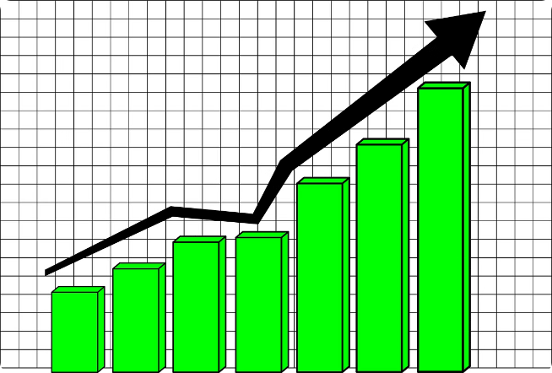


Net Profit
Definition
Net profit is the amount of revenue remaining after all expenses, costs, and taxes have been accounted for.
Calculation
Net Profit = Gross Margin - Operational Expenses - Taxes
Significance
Net profit is the ultimate measure of a company's financial performance and profitability.

Slide 9

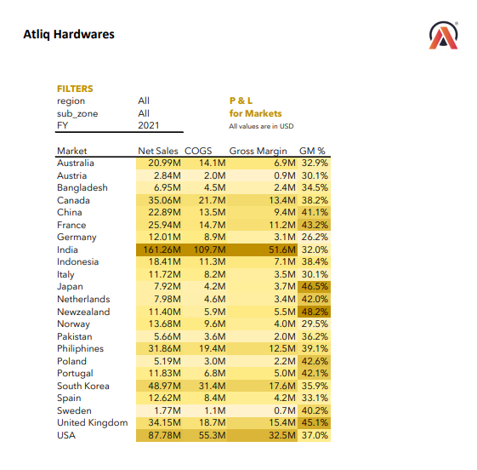




Visualizing the Data
Customer performance
Visualize the top-line revenue by Customer.
Market vs Target Performance
Analyze Market and It’s Target.
P & L Statement by Monthly
Profit and Loss Statement by Fiscal Year and Monthly Wise.
P & L Statement By Market
Profit and Loss Statement Market Wise.

